Slide 1
THE IMPORTANCE OF GREEN ECONOMY IN SUPPORTING DEVELOPMENT IN AFRICA AND THE ARAB WORLD
Paper presented at the Retreat of the Association of Senates, Shoora and Equivalent Councils in Africa and Arab World (ASSECAA)
Excellent hachileka
Undp- regional office for Africa,
addis ababa, ethiopia

Slide 2
Outline of the presentation
The Context of the current Global Crisis
The Impacts of the Global Crisis on African and Arab States
The Green Economy and its importance as an alternative economic approach for Africa and Arab states
Key Green economy strategies and interventions for Africa and Arab states
The role of the Association in the implementation of a green economy approach
Recommendations on how the Association can support implementation of the recommendations
Conclusion and proposed actions

Slide 3
Brief overview of the global economic crisis
Slow recovery from COVID-19
Escalating geopolitical instability due to Russia-Ukraine conflict
High energy prices,
Soaring inflation
High unemployment rates
Budget deficits and debt burden
Increasing interest rates
Global economic slowdown

Slide 4
Climate Change ADDED EFFCTS
Climate change is also a significant challenge for African and Arab countries that is compounded by the COVID-19 pandemic and geopolitical tensions such as the Russia-Ukraine war.
Challenges exacerbated by climate change:
Increase in the frequency and severity of extreme weather events such as droughts, floods, and heatwaves with significant impacts
Exacerbation of social tensions, including displacement, migration, and conflict over scarce resources such as water and land, and environmental impacts, including biodiversity loss, ecosystem degradation, and desertification.

Slide 5
Impacts of the global economic crisis on Africa and arab states
The current global economic crisis has greatly impacted Africa and the Arab world, emphasizing the need for a paradigm shift towards a green economy:
Africa and Arab countries are particularly vulnerable to economic shocks due to their high dependence on commodity exports, which makes them susceptible to price fluctuations in global markets.
The Covid 19 pandemic and related restrictions have caused significant disruptions in trade and investment flows, which have negatively affected economic growth and development in these regions.
The pandemic has disproportionately impacted the informal sector and vulnerable populations, leading to increased poverty and inequality
The escalation of geopolitical tensions and the US-China trade conflict have had ripple effects on global trade and investment flows, creating uncertainty and volatility in financial markets.

Slide 6
Impacts of the global economic crisis on Africa and arab states
The global crisis has resulting in economic slowdown and further exacerbated the already challenging economic conditions in Africa and Arab countries.
High energy prices and inflation have also impacted these regions, leading to increased costs of production, and living.
This has further constrained economic growth, leading to high rates of unemployment, budget deficit, and indebtedness.
The increasing interest rates have also contributed to the economic slowdown in these regions.

Slide 7
Response to the global crisis in Africa and arab states
African and Arab countries have implemented various policy measures such as monetary and fiscal policies, to mitigate the impacts of the crisis.
Stimulus packages to support businesses and households affected by the pandemic
Austerity measures to reduce budget deficits and debt levels
Diversified their economies away from commodity exports
Invested in other sectors, such as technology and renewable energy, to promote sustainable economic growth and development.

Slide 8
Measures that Africa and arab countries can implement to address the impacts of the global crisis
Economic diversification: diversify their economies away from traditional commodity exports and invest in other sectors such as technology, renewable energy, and tourism
Infrastructure development: Investment in infrastructure development such as transport, energy, and telecommunications can help to reduce the cost of doing business, attract foreign investment, and promote regional integration
Human capital development: Investment in education, health, and skills development can help to create a skilled workforce that can drive economic growth and development

Slide 9
Measures that Africa and arab countries can implement to address the impacts of the global crisis
Regional integration: Promoting regional integration through trade agreements, harmonization of regulations, and the creation of regional economic blocs
Entrepreneurship and innovation: Encouraging entrepreneurship and innovation can help to create new businesses and industries, leading to economic growth and development
Sustainable development: Investing in sustainable development can help to address the challenges of climate change, reduce environmental degradation, and promote social and economic development

Slide 10
Green economy
The three concepts of green growth, green economy and sustainable development are interrelated.
According to the OECD, Green growth means – “fostering economic growth and development, whilst ensuring that natural assets continue to provide the resources and environmental services on which our wellbeing relies”.
It provides a practical and flexible approach for achieving concrete, measurable progress across the economic and environmental aspects of development, while taking full account of the social consequences of greening the growth.

Slide 11
Principles of green growth
Sustained economic growth
Resource use efficiency
Climate response – adaptation and mitigation
Creation of decent green jobs
Human wellbeing and social inclusiveness

Slide 12
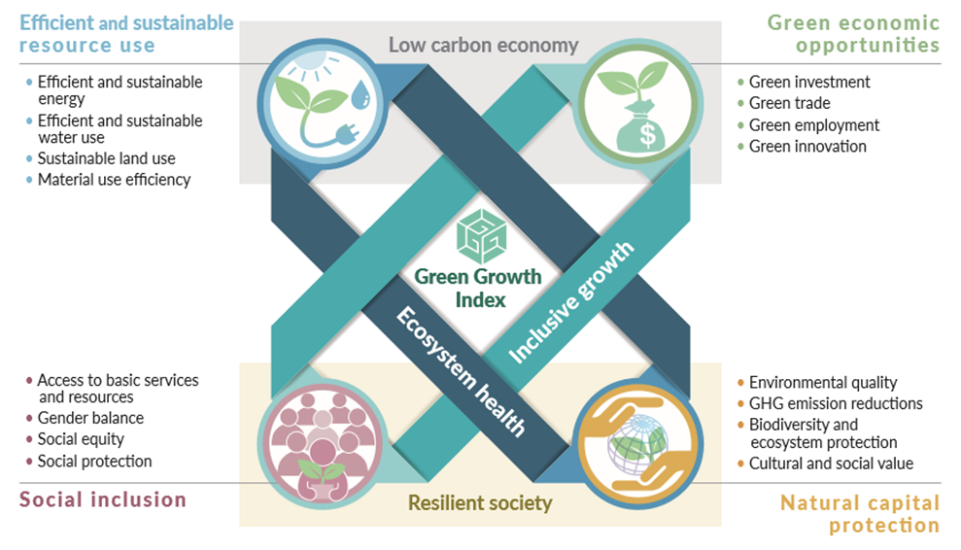

Slide 13
Green economy
An economy that results in “improved human well-being and social equity, while significantly reducing environmental risks and ecological scarcities” (UNEP)
A green economy has four main pillars, namely:
Resource efficiency for achieving greater wellbeing whilst reducing resource use and emissions;
Conserving and protecting the natural resource base
Low carbon and climate-resilient development that encompasses low emission and/or climate-resilient economic growth
Social inclusion with a focus on improving the terms on which individuals and groups take part in the development process

Slide 14
Sustainable development
Sustainable development has three pillars, namely economic, social, and environmental, and is underpinned by five dimensions as articulated in the 2030 Agenda:
Planet, Prosperity, People, Peace, and Partnership
Green growth is believed to be the requirement and ingredient, for green economy and sustainable development.
Green economy cannot be achieved without championing green growth first
Green growth is, therefore, considered as the path to achieve a green economy and ultimately, sustainable development

Slide 15
importance OF PROMOTING GREEN GROWTH IN AFRICA AND ARAB STATES
Promoting a green economy in North Africa, the Middle East, and Sub-Saharan Africa has great potential to address environmental and development challenges in the region while also fostering sustainable economic growth and development.
This is particularly important given that these regions largely depend on commodity market / raw materials trade

Slide 16
Elements and Aspects of a Green Economy
Renewable energy
  Transition from fossil fuels to sustainable energy sources
  Investment in solar, wind, hydro, and geothermal power projects
Sustainable agriculture
  Climate-smart agriculture practices
  Improved soil and water management
  Agroforestry and organic farming
Green infrastructure
  Eco-friendly buildings
  Efficient public transportation
  Smart grid and energy-efficient technologies
Waste management and recycling
  Waste reduction, recycling, and composting programs
  Circular economy principles to minimize waste generation

Slide 17
Elements and Aspects of a Green Economy
Ecosystem restoration and conservation
  Protection and restoration of forests, wetlands, and other natural habitats
  Sustainable use of natural resources and biodiversity conservation
Climate-resilient development
  Integrating climate change adaptation and mitigation measures in development planning
  Enhancing the resilience of infrastructure, agriculture, and coastal zones
Green finance
  Mobilizing financial resources for sustainable projects
  Encouraging private sector investment in green initiatives

Slide 18
Green economy Examples
Renewable energy: Morocco's Noor Solar Power Station
  World's largest concentrated solar power plant
  Reduces dependence on imported fossil fuels
  Increases renewable energy capacity, supporting energy security
Sustainable agriculture: Kenya's climate-smart agriculture
  Promotes agroforestry, conservation agriculture, and water management practices
  Increases productivity while conserving resources
  Enhances climate resilience and food security
Green infrastructure: Masdar City, United Arab Emirates
  Low-carbon, sustainable urban development
  Eco-friendly buildings, renewable energy, and efficient public transportation
  Aims to achieve zero waste and zero carbon emissions

Slide 19
Green economy Examples
Waste management and recycling: Nigeria's Wecyclers initiative
  Incentivizes households to recycle through redeemable points
  Encourages waste segregation and recycling
  Reduces waste sent to landfills and fosters a circular economy
Ecosystem restoration and conservation: The Great Green Wall initiative in Africa
  Aims to restore 100 million hectares of degraded land across the Sahel
  Improves food security, biodiversity, and resilience to climate change
  Provides job opportunities and supports local communities
Climate-resilient development: Egypt's Integrated Coastal Zone Management project
  Protects coastal communities from rising sea levels and storm surges
  Implements ecosystem-based adaptation measures
  Enhances the resilience of coastal infrastructure and ecosystems

Slide 20
Green Financing Mechanisms
Carbon trading
  Establishing regional carbon markets for trading emissions allowances
  Incentivizes emissions reductions and supports clean technology investments
Green bonds
  Issuing debt securities to finance environmentally friendly projects
  Attracts investment in renewable energy, sustainable agriculture, and green infrastructure
Blue bonds
  Financing instruments specifically designed for marine and ocean-based projects
  Supports sustainable fisheries, marine conservation, and coastal management initiatives
Debt-for-nature swaps
  Agreements between debtor countries and creditors to reduce debt in exchange for commitments to environmental conservation
  Redirects debt payments towards funding local conservation projects

Slide 21
Examples of Green Financing Mechanisms
Carbon trading: African Development Bank's African Carbon Support Program
  Assists African countries in accessing carbon finance
  Supports the development of carbon market infrastructure and capacity building
Green bonds: Tunisia's sovereign green bond issuance
  First sovereign green bond in North Africa
  Funds renewable energy, sustainable agriculture, and green infrastructure projects
Blue bonds: Seychelles' world-first sovereign blue bond
  Raises funds for marine conservation and sustainable fisheries
  Supports the transition to a blue economy and protects marine resources
Debt-for-nature swaps: Madagascar Foundation's debt-for-nature swap agreement with the United States
  Converts a portion of Madagascar's debt into funding for conservation programs
  Supports the protection of unique biodiversity and ecosystems in the country

Slide 22
The Importance of Collective Action FOR A GREEN ECONOMY
The success of the green economy transition depends on the collective action of all stakeholders:
The role of parliamentarians is crucial in providing leadership, guidance, and oversight throughout the process must be re-emphasized
Collaboration and dialogue among government agencies, the private sector, civil society, academia, and international partners is encouraged
A green economy is not just an environmental imperative, but also a pathway towards economic prosperity, social equity, and resilience in the face of global challenges

Slide 23
Role of assecAa in Championing Adoption and Implementation of green economy
Legislative support
  Draft, sponsor, and support legislation that promotes the green economy
  Develop laws that incentivize renewable energy, sustainable agriculture, waste management, and green infrastructure projects
Advocacy and awareness
  Use public platforms to raise awareness of the benefits of a green economy
  Engage with the media, participate in public events, and utilize social media to educate citizens and stakeholders
Budgetary allocations
  Influence the allocation of government funds to support green economy initiatives
  Advocate for increased investments in renewable energy, sustainable agriculture, ecosystem restoration, and other priority areas
Oversight and accountability
  Monitor the implementation of legislation and ensure adherence to green economy principles
  Investigate allegations of non-compliance and hold public hearings to ensure transparency and accountability

Slide 24
Role of the ASSECCA in Championing Adoption and Implementation of green economy
Regional and international collaboration
  Participate in inter-parliamentary dialogues and engage with international organizations
  Form partnerships with development agencies to share knowledge, resources, and best practices
Capacity building and training
  Organize capacity building programs for parliamentarians on green economy knowledge and skills
  Conduct workshops, seminars, and study visits to learn from successful initiatives in other countries
Policy dialogue and stakeholder engagement
  Facilitate policy dialogues and engage with stakeholders such as civil society, private sector, academia, and international organizations
  Develop a shared vision for the green economy and create consensus on sustainable development and implementation

Slide 25
Recommendations to ASSECAA
Support development and implementation of national green economy strategies aligned with the United Nations Sustainable Development Goals (SDGs)
1
Promote establishment regional partnerships for knowledge and resource sharing in green initiatives
2
Support research and innovation in clean technologies and sustainable practices
3
Encourage private sector involvement in green economy initiatives through incentives and regulatory frameworks
4
Support development and utilization of green finance instruments, including carbon trading, green bonds, and debt-for-nature swaps to mobilize investments for sustainable projects
5
Strengthen capacity building and technical assistance programs for the development of green skills and entrepreneurship
6
Promote collaboration with international organizations, development partners, and civil society to support green economy initiatives and projects
7

Slide 26
conclusion
There is great potential for meaningful change and a sustainable future through the adoption and implementation of green economy strategies for Africa and Arab countries for sustainable and more resilient economies

Slide 27
MOVING FORWARD:
Short-term actions (1-2 years)
Establish
Establish a parliamentary committee focused on green economy and sustainable development.
Initiate
Initiate stakeholder consultations to develop national green economy strategies.
Identify
Identify key sectors for immediate green interventions, such as renewable energy and sustainable agriculture.
Mobilize
Mobilize resources and support for pilot projects in these key sectors.

Slide 28
Medium-term actions (3-5 years)
Implement
Implement national green economy strategies with clear targets and monitoring mechanisms
Scale up
Scale up successful pilot projects and expand green initiatives to other sectors.
Establish
Establish a national green financing mechanism to channel public and private investments into sustainable projects
Strengthen
Strengthen regional and international partnerships to share knowledge, technology, and best practices

Slide 29
Long-term actions (6-10 years)
Achieve
Achieve significant progress towards national green economy targets and the United Nations Sustainable Development Goals (SDGs)
Ensure
Ensure that green economy principles are integrated across all sectors of the economy
Monitor
Monitor progress, evaluate impact, and continuously update and improve the national green economy strategy
Foster
Foster a culture of sustainability and environmental stewardship among citizens and stakeholders

Slide 30
Thank you

