Slide 1
The future of the Afro-Arab economies in light of the successive global economic crisis and ongoing global geopolitical tension and instability
By UNDP

Slide 2
Outline
African Continental Free Trade Area (AfCFTA) in brief
Intra trade impacts
Strategic importance, benefits, threats
Conclusions

Slide 3
INTEGRATION IN AFRICA: HISTORICAL CONTEXT AND BACKGROUND
.

Slide 5
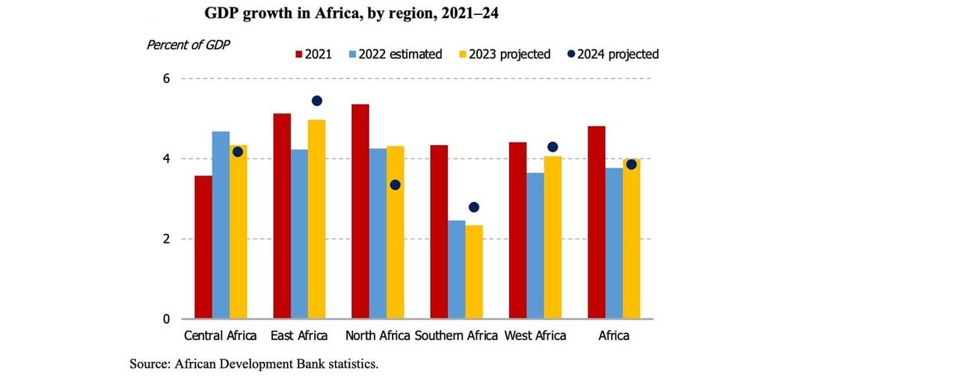
African economies remain resilient with a stable outlook in 2023-2024, despite the tightening global financial conditions, the African Development Bank has projected in a new report.

Slide 6
Global development challenges
SLOW STRUCTURAL TRANSFORMATION AND LIMITED ECONOMIC DIVERSIFICATION
LOW HUMAN CAPITAL VALUATION (High prevalence of poverty, inequalities and unemployment)
GOVERNANCE WEAKNESSES
CLIMATE CHANGE ISSUES

Slide 7
1. Global Risks 2023
current crises (i.e. global risks which are already unfolding),
risks that are likely to be most severe in two years, and
risks that are likely to be most severe in 10 years. This chapter address the outlook for the first two time frames.
1.1. current crises
Most respondents to the 2022-2023 Global Risks Perception Survey (GRPS) chose “Energy supply crisis”; “Cost-of-living crisis”; “Rising inflation”; “Food supply crisis” and “Cyberattacks on critical infrastructure” as among the top risks for 2023 with the greatest potential impact on a global scale (Figure 1.1).

Slide 8
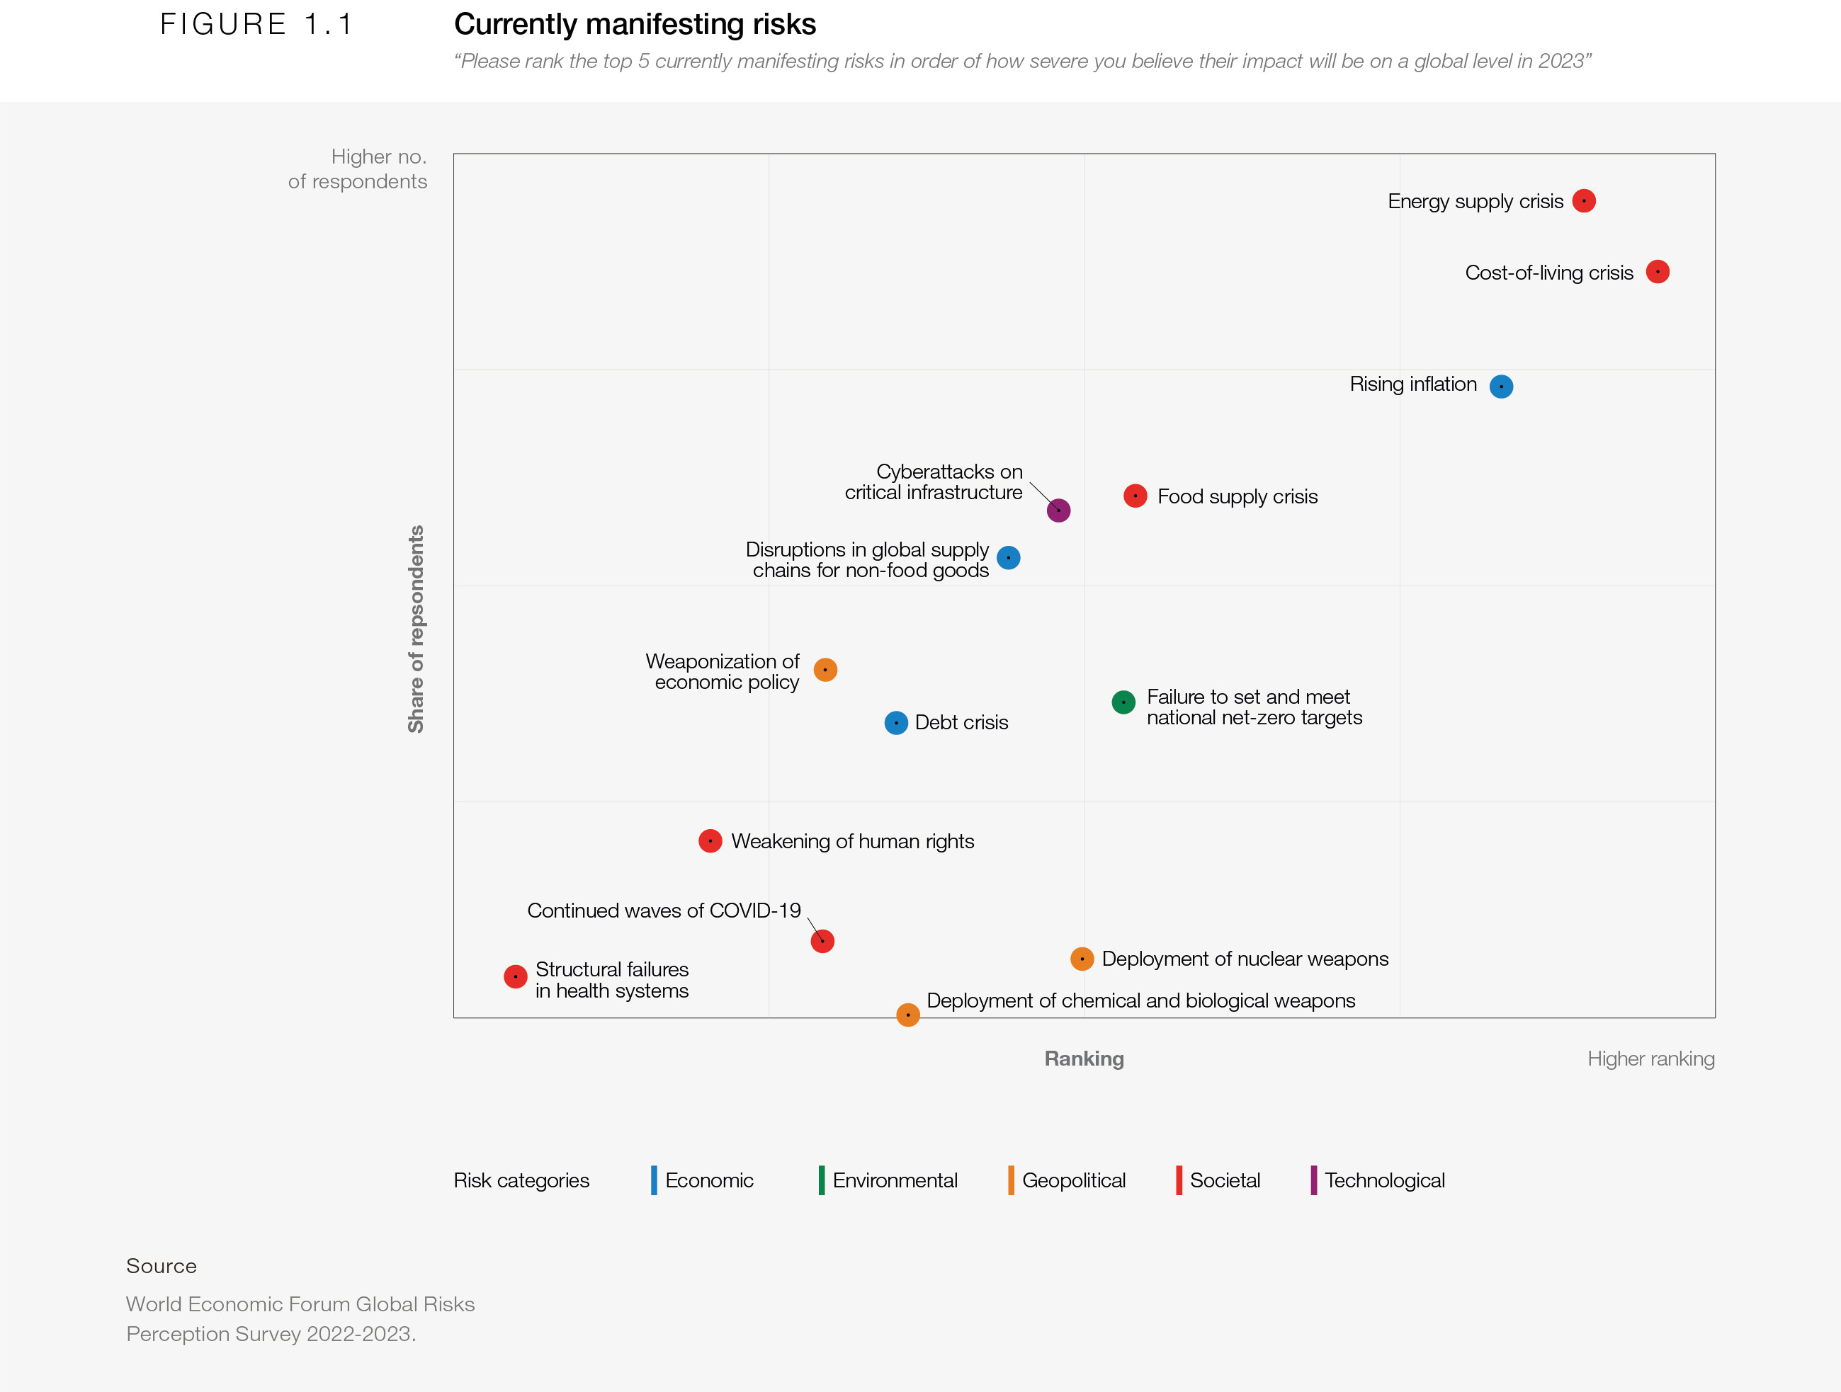
Our global “new normal” is a return to basics – food, energy, security – problems our globalized world was thought to be on a trajectory to solve.

Slide 9
The complex and rapid evolution of the global risks landscape is adding to a sense of unease. More than four in five GRPS respondents anticipated consistent volatility over the next two years at a minimum, with multiple shocks accentuating divergent trajectories (Figure 1.10). Respondents to the GRPS see the path to 2025 dominated by social and environmental risks, driven by underlying geopolitical and economic trends (Figure 1.2).
1.2. The path to 2025

Slide 10
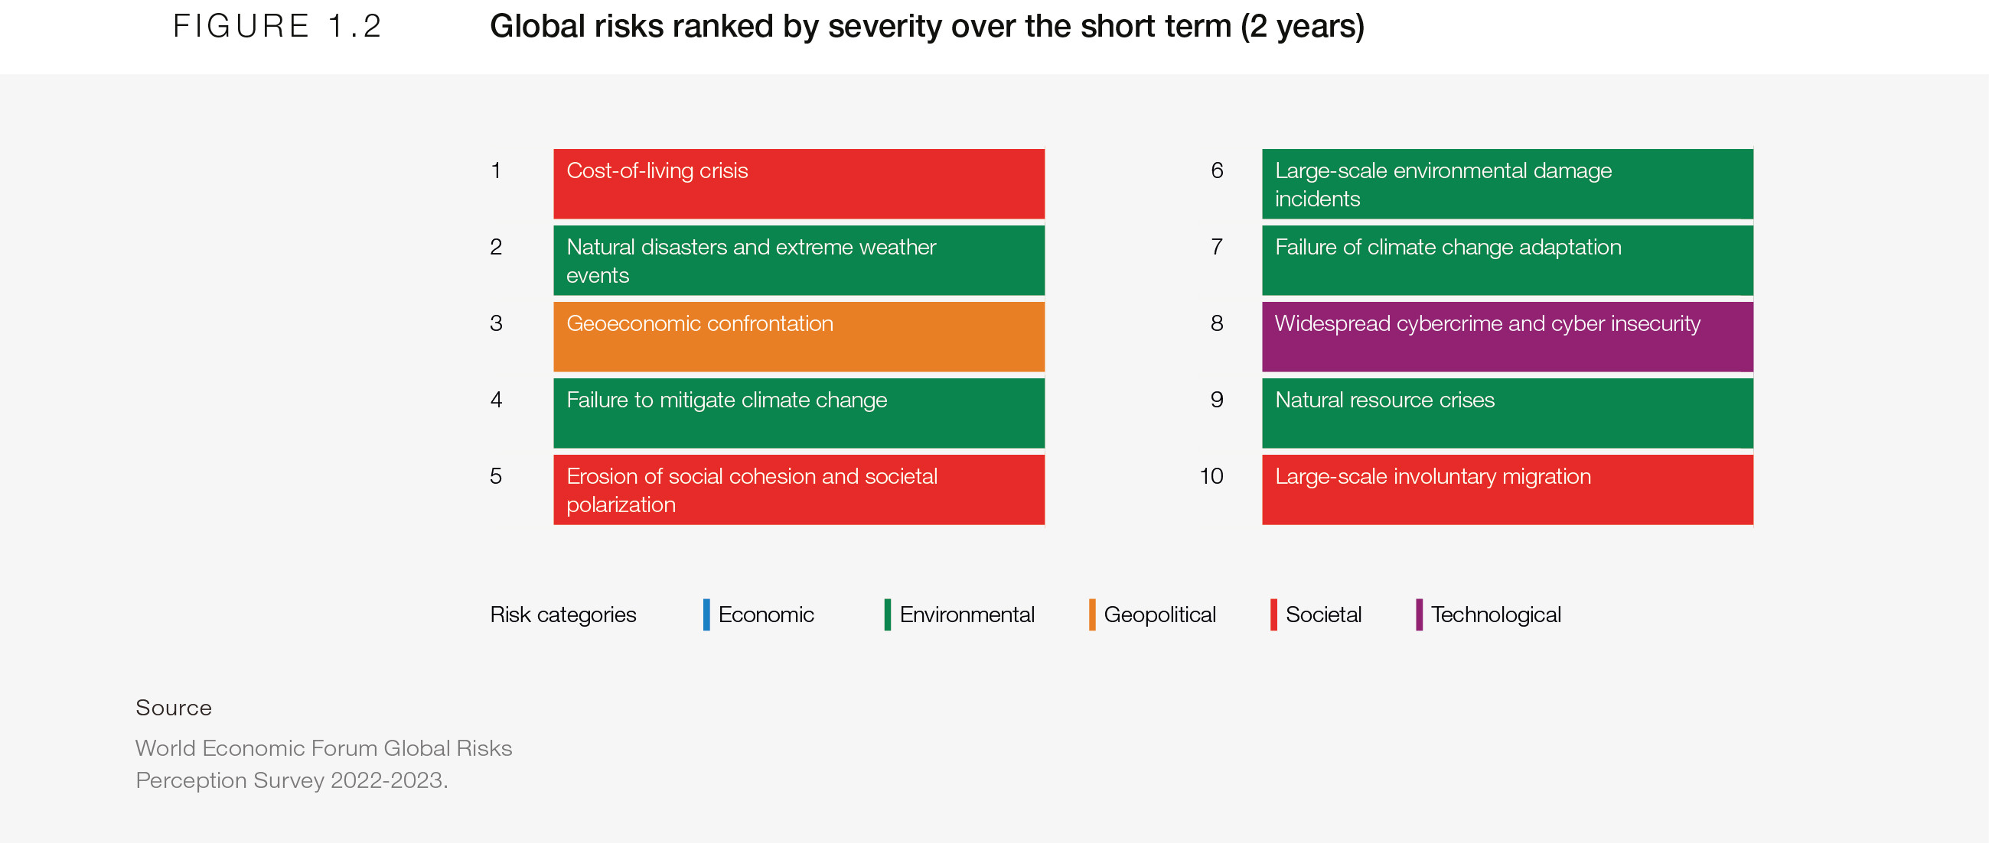

Slide 11
Shocks of recent years – most notably, the war in Ukraine and COVID-19 pandemic – have reflected and accelerated an epochal change to the global order. Risks that are more severe in the short term are embedding structural changes to the economic and geopolitical landscape that will accelerate other global threats faced over the next 10 years.
1.3. Looking ahead

Slide 12
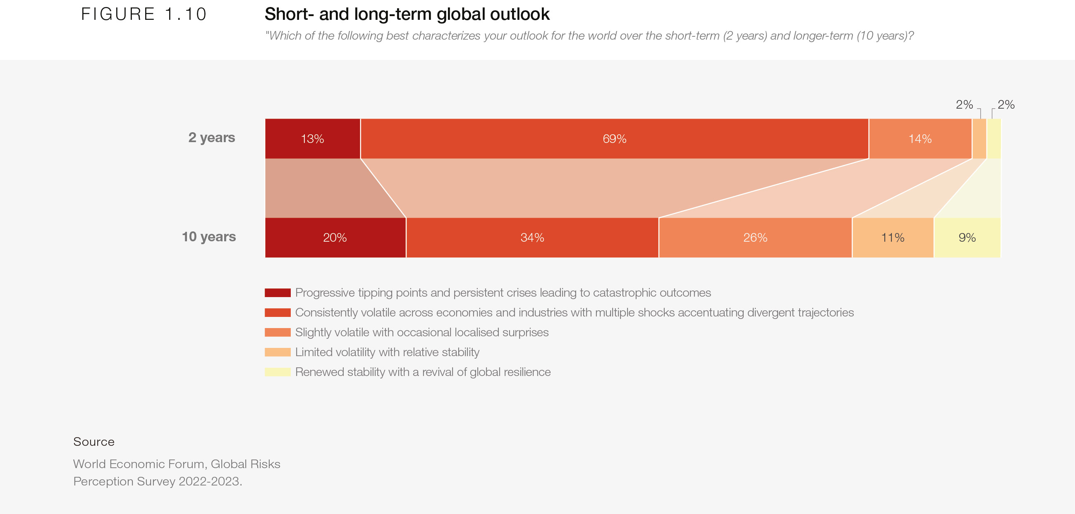

Slide 13
THANK YOU!

